Slide 1



2025–2026
ANNUAL MILITARY
EQUIPMENT REPORT
Use, Inventory, and Proposed Equipment Changes

Slide 2
WHY WE ARE HERE
This report explains what equipment ACSO has, how it was used, what it cost, and what changes are being requested. Tonight is also an opportunity to ask questions and share concerns.
“Military equipment” is a term defined by state law. It includes equipment such as drones, robots, armored vehicles, and certain firearms and munitions. It does not necessarily mean the equipment came from the military.
2025–2026 Annual Military Equipment Report

Slide 3
REPORT AT A GLANCE
1,201
1,032
6,825
$62,096
Total operational equipment uses
Drone deployments
Employee training hours
Outside course fees
0
0
Complaints or concerns
Policy violations identified
We recorded 1,201 equipment uses during the reporting period. This does not mean 1,201 separate incidents. One incident can involve multiple equipment uses, including more than one drone deployment. Drones accounted for most of the recorded activity.
2025–2026 Annual Military Equipment Report

Slide 4
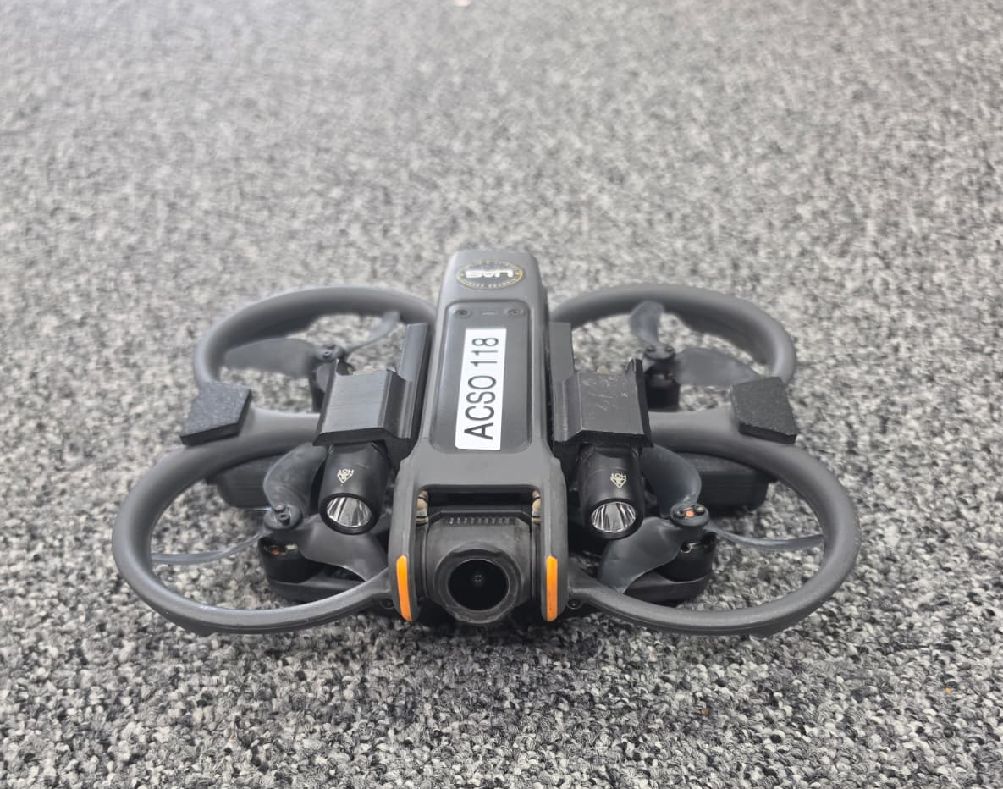
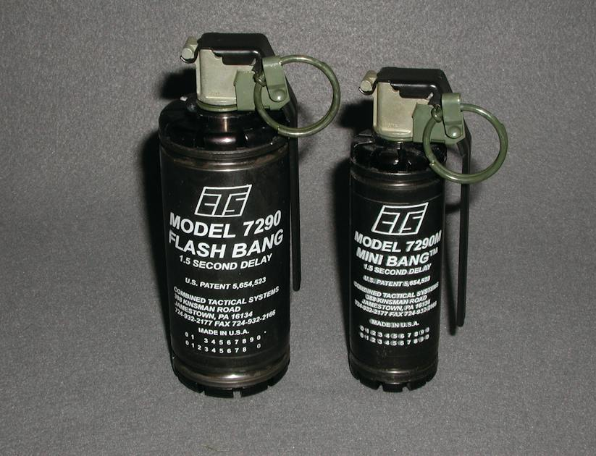
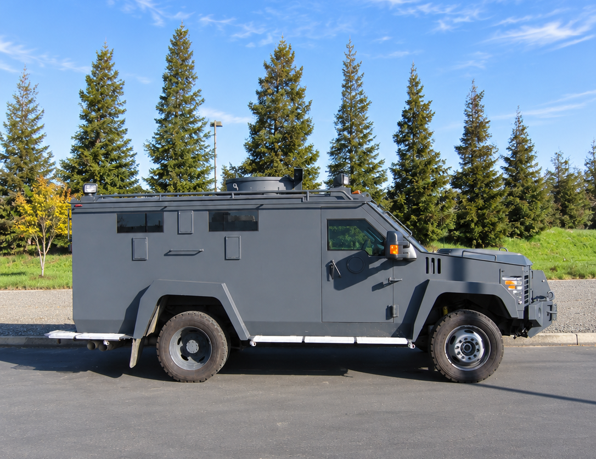
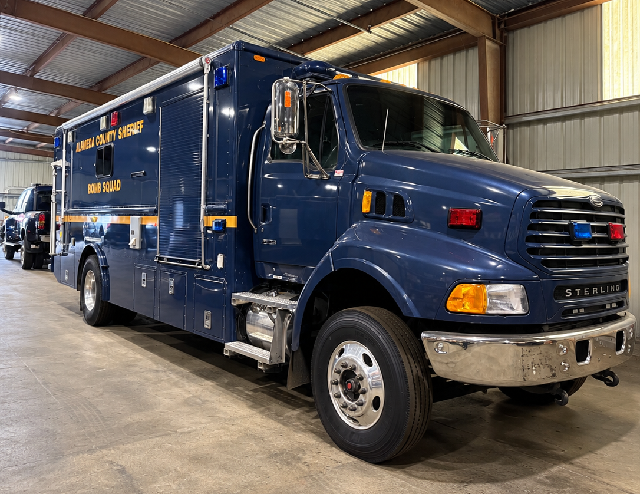
WHAT WE USED MOST AND WHY
1,032 uses
35 uses
NOISE DISTRACTION
DEVICES
DRONES
Aerial Views | Searches
Light and Sound distraction
34 uses
20 uses
ARMORED
RESCUE VEHICLE
EOD VEHICLE
Transport Bomb Squad Personnel & Equipment
Protection | Rescue
2025–2026 Annual Military Equipment Report

Slide 5
MOST COMMON REASONS FOR DEPLOYMENT
* SEE APPENDIX D
General DFR and other public-safety calls
500
Suspect, vehicle, or area searches
174
Search warrants and warrant service
419
EOD, fire, or hazardous incidents
25
Barricaded, armed, or crisis incidents
83
2025–2026 Annual Military Equipment Report

Slide 6
EQUIPMENT PURCHASES & FUNDING
$20,386.00
5 sUAS Units
Total
Equipment Cost
Actual Cost
After Reimbursements
$51,000.00
›
›
$85,656.08
$16,000.00
rifle reimbursement
$69,656.08
8 Accuracy International Rifles
(SRU SCOUT RIFLES)
$14,270.08
8 Pepperball Launchers
(FOR SRU MEMBERS ONLY)
Funding sources: sUAS Budget and SRU Budget
2025–2026 Annual Military Equipment Report

Slide 7
TOTAL TRAINING HOURS
6,825
Employee training hours
1,141 HOURS
5,684 HOURS
Unit-level training
Formal Courses
379
Course attendees
Specialized Training
sUAS Training
DFR
Training
ACSO RTC
Outside Vendors
2025–2026 Annual Military Equipment Report

Slide 8
TIME SPENT USING EQUIPMENT IN OPERATIONS
550.09 HOURS
Total Operation Person-Hours
189.75 HOURS
114 HOURS
170.12 HOURS
76.22 HOURS
Agency Reports
Special Events
sUAS
Drone First Responder
SERGEANTS
DEPUTIES
TECHNICIANS
226.45 HOURS
317.09 HOURS
6.55 HOURS
2025–2026 Annual Military Equipment Report

Slide 9
COMPLAINTS, AUDITS, AND COMPLIANCE
During this reporting period, the ACSO received no complaints or concerns regarding the use of military equipment.
0
Complaints or concerns
The Military Equipment Coordinator reviews tracking and audit records, and ACSO completed an annual agency-wide inventory audit.
Questions or concerns: acso-mil-equip@acgov.org
Formal complaints: https://www.alamedasheriff.gov/community/citizen-complaint
0
Policy violations identified
2025–2026 Annual Military Equipment Report

Slide 10
WHAT ACSO HAS COMPARED TO WHAT IS APPROVED
Quantities Possessed
BOS Approved
sUAS
258
Category 1
92
Ground robots
17
Category 1
11
Armored Rescue Vehicles
4
Category 2
4
7
Command/Control Vehicles
7
Category 5
Specialized firearms
Category 10
412
454
44,623
rounds
Category 10
37,459
rounds
Specialized ammunition
1,574
Category 12
1,539
Chemical agents / diversionary devices
3
Long Range Acoustic Devices
3
Category 13
66 / 22,369
rounds
Category 14
66 / 22,899
rounds
Projectile Launchers / munitions
2025–2026 Annual Military Equipment Report

Slide 11
EQUIPMENT REMOVED AND NO LONGER ON HAND
FN 303 Less Lethal Launcher - Ending Inventory reduced to zero.
23 Launchers were removed from duty stations
7,126 projectiles removed from inventory
1,125 clear
1,825 indelible paint
735 PAVA/OC
3,441 washable paint
The annual review considers use, condition, cost, alternatives and newer technology before recommending inventory changes.
2025–2026 Annual Military Equipment Report

Slide 12
COMMUNITY QUESTIONS RECEIVED IN ADVANCE
1
2
Multi-Projectile Munitions
Drone Video
Defense Technology #1087, #6064, and #6098
Where is footage stored, and which retention rules apply?
3
4
Older Equipment
Large Drone Authorization Gaps
Does the equipment still meet a current operational need?
Do approved maximums still reflect current needs?
2025–2026 Annual Military Equipment Report

Slide 13
EXISTING MUNITIONS RAISED DURING COMMUNITY DISCUSSIONS
340
203
70
REMOVED
#Def Tec #6064 - 40MM Multiple Rubber Baton Round
#Def Tec #1087 - Stinger 60-Caliber Rubber Ball Canister
Def Tec #6098 - 40MM Multiple Wood Baton Round
ETS
40
SRU
300
CIVIL
10
DPS
10
SCM
6
SRU
70
NCM
6
RCD
10
SRT
23
SRU
138
2025–2026 Annual Military Equipment Report

Slide 14
OTHER COMMUNITY QUESTIONS
2
Drone Video
Where is footage stored, and which retention rules apply?
3
4
Older Equipment
Large Drone Authorization Gaps
Does the equipment still meet a current operational need?
Do approved maximums still reflect current needs?
2025–2026 Annual Military Equipment Report

Slide 15
sUAS APPROVED QUANTITY REVIEW
The UAS Unit reviewed older and discontinued drone models and recommended reducing approved quantities.
Recommended adjustment
Remove
Reduce
Training only
−161
Lower approval for older models that are still in limited service.
Models with 0 in service or no current operational need.
Some older aircraft will be moved out of operational service and used for training.
approved sUAS amounts
Why this matters
This directly addresses the gap between approved and possessed drone quantities.
The review identified older equipment that no longer match current needs.
2025–2026 Annual Military Equipment Report

Slide 16
sUAS REDUCTION BREAKDOWN
Recommended reductions to older or discontinued drone approvals
Drone model
Reduction
Drone model
Reduction
Brinc Lemur 2
−12
DJI Mavic 2 Enterprise Advanced
−13
DJI Matrice 210 V2
−1
DJI Mavic Enterprise Dual
−13
DJI Matrice 210 V2 RTK
−1
DJI Mavic 2 Pro Platinum
−1
DJI Matrice 3TD
−8
DJI Mini 4
−16
DJI Mavic 2 Enterprise Zoom
−17
DJI Mini 5
−16
DJI Mavic 3 Enterprise
−9
DJI Mavic Pro Advanced
−6
DJI Mini
−9
DJI Phantom 4 Pro
−3
DJI Mini 2
−13
DJI Phantom 4 Pro V2
−5
DJI Mini 3
−17
DJI Spark
−1
Before review
Reduction
After review
Current
Remaining gap
258 approved
−161
97 approved
92 possessed
5
2025–2026 Annual Military Equipment Report

Slide 17
PROPOSED ACQUISITIONS
TECHNOLOGY UPDATES
NEW / REPLACEMENT EQUIPMENT
Four Approved Types
Four New Types
DJI Matrice 4E +5 ($5,200 each)
DJI Matrice 4T +22 ($7,300 each)
DJI Matrice 4TD +19 ($7,500 each)
DJI Avata 2 +20 ($1,200 each)
Skydio R10 +32 ($4,995 each)
DJI Avata 360 +24 ($1,500 each)
SIG Sauer MCX-SPEAR LT +50 ($2,251 each)
PepperBall VXR Shatter +500 (approx. $4,000)
2025–2026 Annual Military Equipment Report

Slide 18
WHY THESE REPLACEMENTS ARE BEING REQUESTED?
PepperBall Jammer Round
PepperBall VXR Shatter
Replace the Jammer round which was never produced.
LWRC M61C 5.56x45MM
SIG SAUER MCX-SPEAR LT IR 5.56 11.5" SBR
Replace Special Response Unit's inventory of LWRC M61C and ICDI rifles.
2025–2026 Annual Military Equipment Report

Slide 19
COMMUNITY ENGAGEMENT MEETING
October 12, 2026
Cherryland Community Center | Hayward
Community members had an opportunity to:
Review the Annual Military Equipment Report
Ask questions about ACSO's military equipment program
Provide comments and feedback
Discuss equipment use, inventory, costs, and proposed acquisitions
Questions raised were addressed by ACSO staff and subject matter experts.
2025–2026 Annual Military Equipment Report

Slide 20
NEXT STEPS
1
2
October 12
October 22
Community Engagement Meeting
Completed
Public Protection Committee
Review Annual Military Equipment Report and proposed changes
3
4
November 17
After Board Action
Full Board of Supervisors
Expected consideration of the Annual Report, policy renewal, and proposed equipment changes
If approved, ACSO will update the approved inventory and move forward with authorized acquisitions through the normal purchasing process.
2025–2026 Annual Military Equipment Report

Slide 21
Questions?
2025–2026 Annual Military Equipment Report

