Slide 1
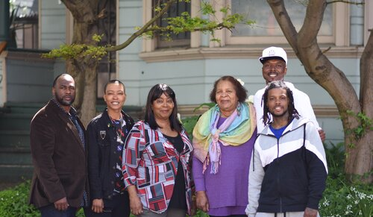
Alameda County Fair Chance Housing Outreach & Participatory Research Proposals
PURPOSE OF GRANTS: HOMELESS PREVENTION OF RE-ENTRY POPULATION AND RE-INTEGRATION HOUSING SUPPORT RESEARCH
Ensure that people returning home know about new rights to housing access AND re-entry housing resources
Participatory research to show how housing access affects reintegration success

Slide 2
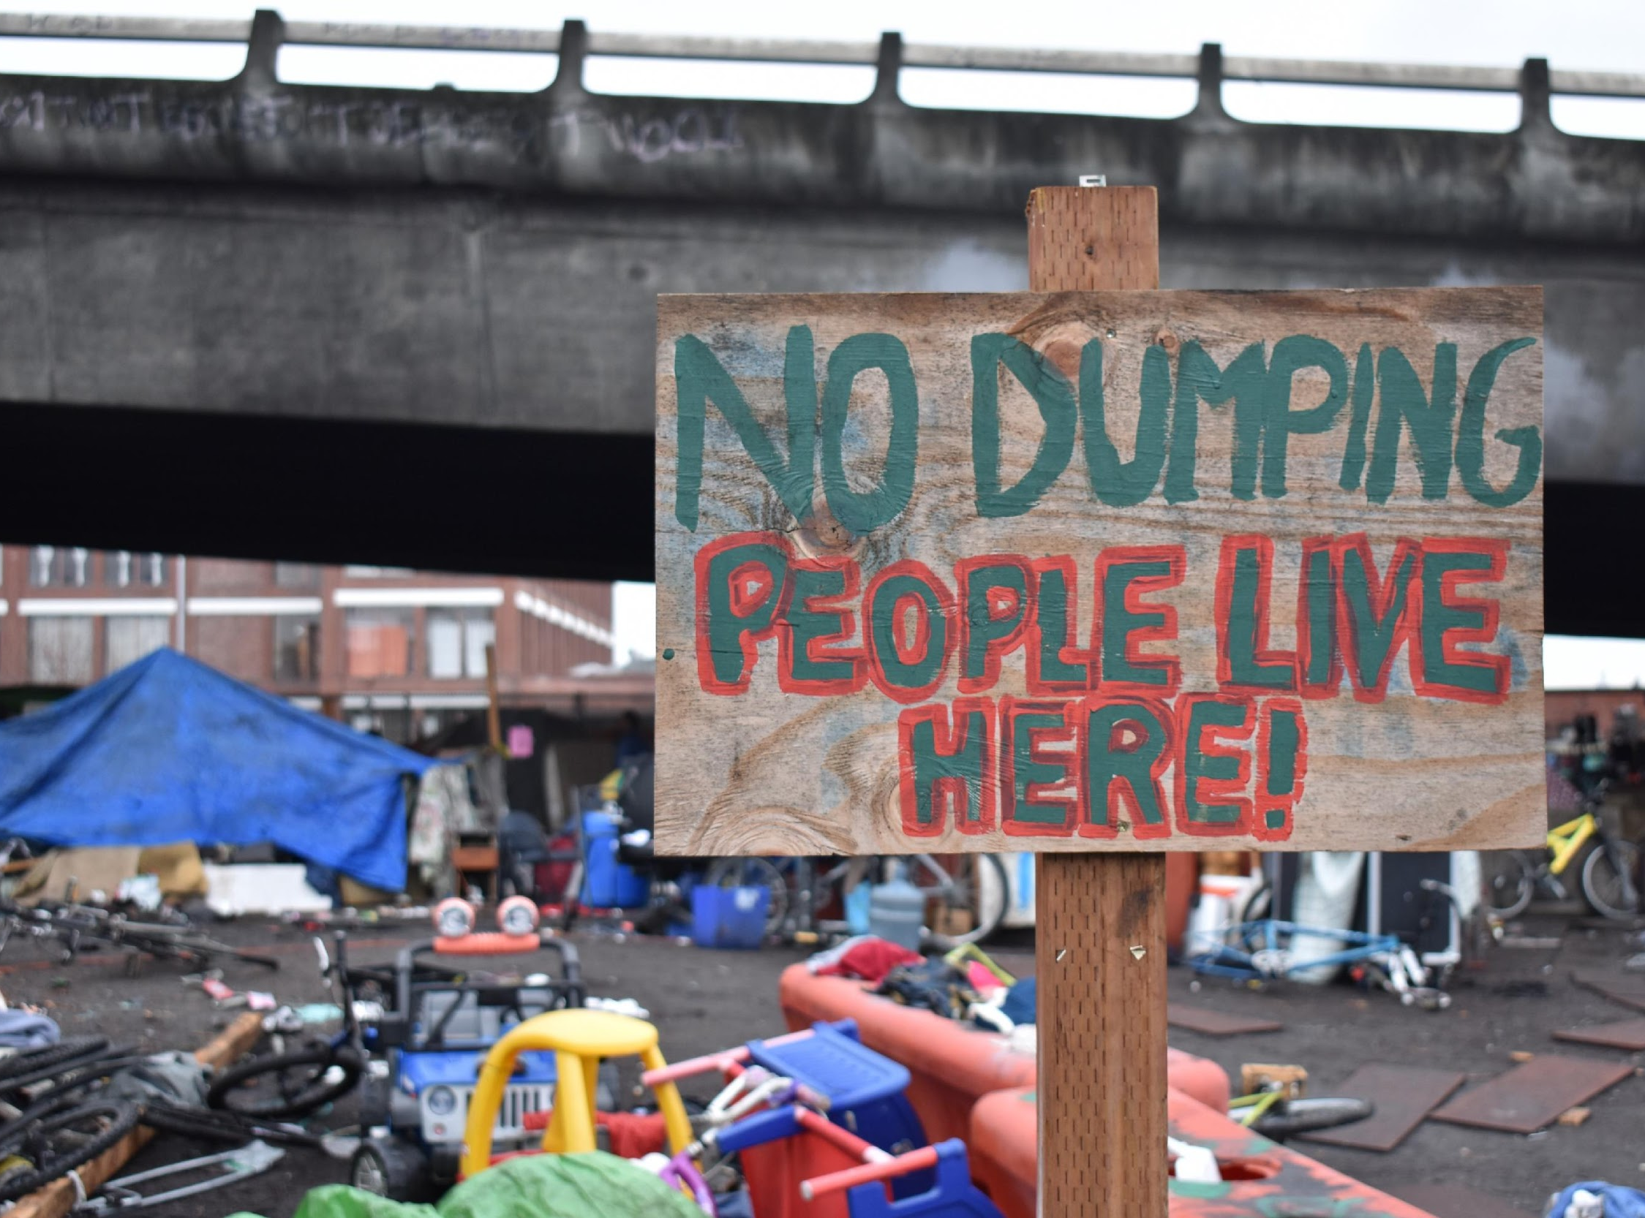
Grant Proposal on Re-entry Homelessness Prevention: Community Outreach on Fair Chance Housing & Re-entry Housing Resources
Partnership: Just Cities, AUON, BOSS, ASPC, CURYJ
73% of Oakland Homeless Encampment residents have a criminal record (Just Cities/Goldman School research survey)
Ensure that 20,000 residents know about new legal rights AND housing resources
Network power with leading re-entry groups
COVID outreach
Power of cultural arts & inspiration
Networks + Safe Street Outreach + Social Media + Multimedia + Billboards/Bus Ads
Leverages $532,000/2 years from City of Oakland & private foundations
AC Request: $176,000/2 years

Slide 3
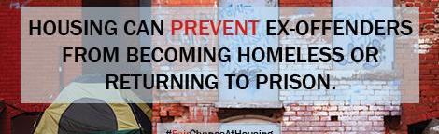
Grant Proposal on Housing & Re-entry Participatory Impact Evaluation Study
Current research gaps on housing/re-entry
Partnership w/ Prof Veronica Terriquez, UCLA Urban Planning, Just Cities & UC Berkeley Future Histories Lab & City Planning
Co-led by Re-entry Leaders for transformative justice research model
Evaluates impact of the FCH policies & housing stability to re-entry success
Assesses any unintended consequences of removing discriminatory barrier
Private/Public Funding Committed: $264,000/2years
AC Request: $154,000/2 years

Slide 4
Fair Chance Housing Policy Participatory Impact Evaluation- Purpose & Results
First evaluation study of fair chance housing policies in the nation
Provides data that Oakland & Berkeley government officials need to maintain the ordinances
Provides data that other jurisdictions are looking for in order to pass new fair chance housing laws
Potential resulting data from the impact evaluation study:
  How many people were able to access housing when discrimination was removed?
  What types of housing were people able to access? (This helps make the case that formerly incarcerated people are not a monolith)?
  What support services and resources were available and needed to find and maintain housing?
  What are ongoing housing barriers?
  What are any unintended consequences of removing discrimination?

Slide 5
Reentry Housing Research- Purpose & Results
Provide data on the relationship between housing stability and anti-recidivism:
Lack of adequate research on housing and anti-recidivism
Shift funding priorities for dignified housing for formerly incarcerated people, and other solutions that lead to successful reintegration

Slide 6
Distinction from BARHII Work
BARHII- Providing leadership training programs on racial equity
→ BARHII is not conducting an evaluation of Fair Chance Housing policies enacted in Berkeley and Oakland.
→ BARHII is not conducting research on reentry housing and the role of housing stability on anti-recidivism.

