Slide 1
Overview of Opioid Use Disorder and Treatment for Our Youth
Wednesday, November 13, 2023
William Burrough, MD, MPH
Assistant Clinical Professor / Pediatrician
UCSF Benioff Children’s Hospitals
Formatted from original presentation by:
Monish Ullal, MD
Associate Medical Director
Alameda Health Systems Bridge Clinic

Slide 2
Disclosures
No planners or speakers have any relevant financial relationship with commercial interests to disclose.

Slide 3
Learning Objectives
1. Understand the scope of opioid use disorder in youth and racial disparities that exist in connection to evidence-based treatment
2. Recognize the importance of life-saving medications for opioid use disorder (MOUD) and address common misconceptions
3. Learn more about what the medical unit is doing to evaluate for and treat opioid use disorder (and other substance use disorders)

Slide 4
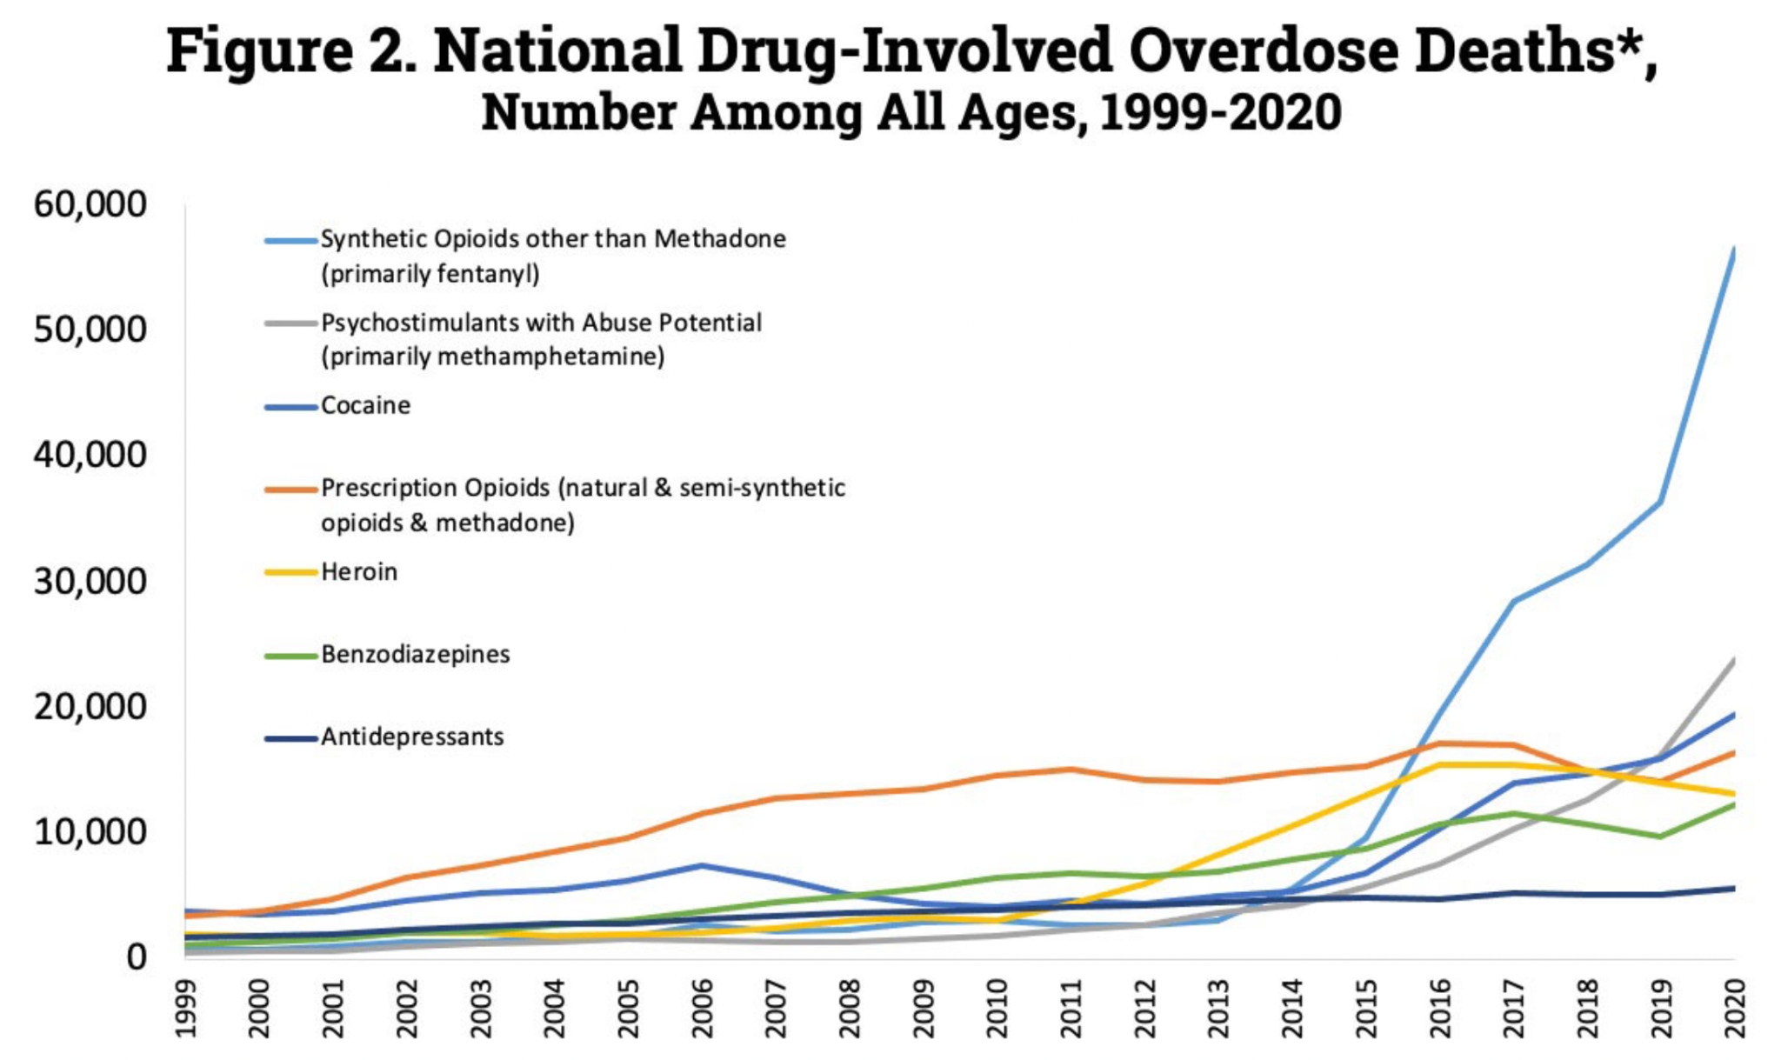
The Problem: Overdose deaths are skyrocketing
91,799 overdose deaths in 2020
107,622 overdose deaths in 2021
110,000 overdose deaths in 2022
Annual drug overdose deaths exceed those from motor vehicle crashes, gun violence, and HIV at its peak
Fentanyl use and overdose is on the rise in our region
Centers for Disease Control and Prevention, National Center for Health Statistics. Multiple Cause of Death 1999-2020 on CDC WONDER Online Database, released 12/2021
Ahmad FB, Cisewski JA, Rossen LM, Sutton P. Provisional drug overdose death counts. National Center for Health Statistics. 2022.

Slide 5
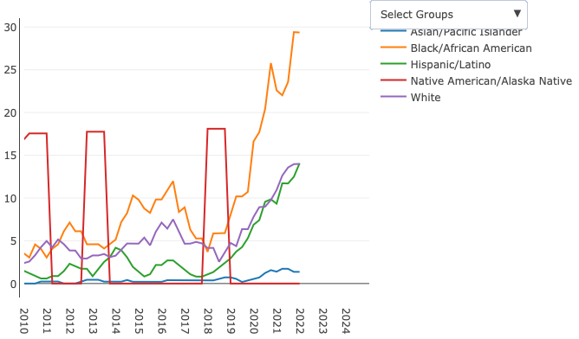
Alameda County Overdoses Continue to Increase
Highest mortality in Black and AI/AN populations
CDPH Ovderdose Dashboard: https://skylab.cdph.ca.gov/ODdash/?tab=CTY

Slide 6
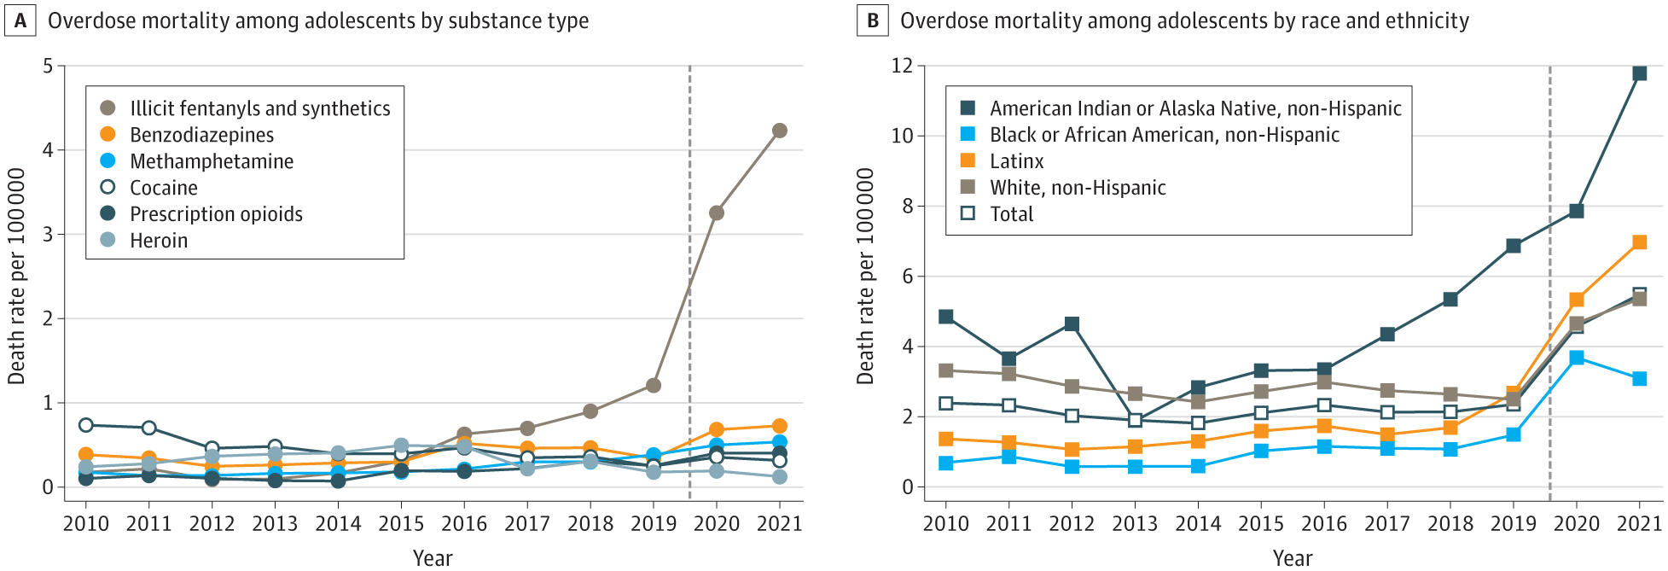
Trends similar among adolescents
Friedman J, Godvin M, Shover CL, Gone JP, Hansen H, Schriger DL. Trends in Drug Overdose Deaths Among US Adolescents, January 2010 to June 2021. JAMA. 2022;327(14):1398–1400. doi:10.1001/jama.2022.2847

Slide 7
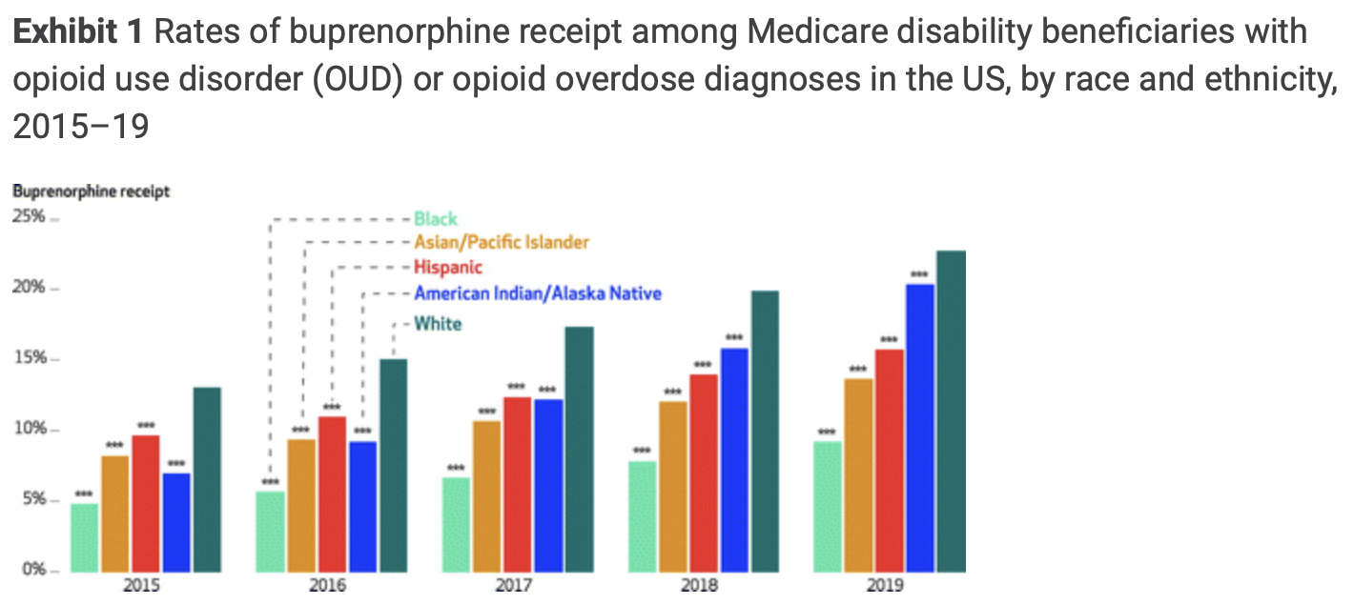
Racial disparities in treatment access
Miles J, Treitler P, Lloyd J, Samples H, Mahone A, Hermida R, Gupta S, Duncan A, Baaklini V, Simon KI, Crystal S. Racial And Ethnic Disparities In Buprenorphine Receipt Among Medicare Beneficiaries, 2015-19. Health Aff (Millwood). 2023 Oct;42(10):1431-1438. doi: 10.1377/hlthaff.2023.00205. PMID: 37782874.

Slide 8
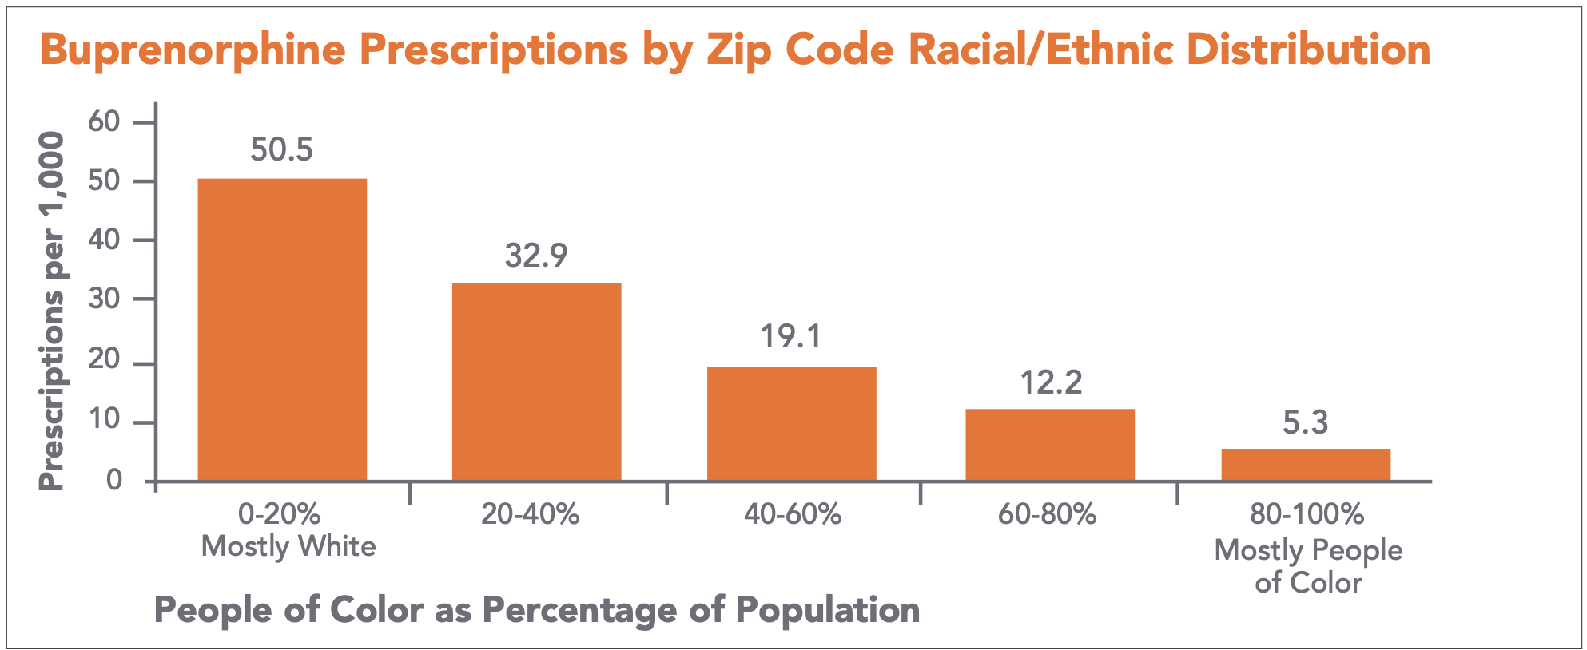
Racial disparities in treatment access
CA Bridge. Racial Disparities in Access to Medication for Addiction Treatment. https://bridgetotreatment.org/resource/racial-disparities-in-access-to-medication-for-addiction-treatment/

Slide 9
For people with OUD, Suboxone reduces the risk of death from any cause by > 50% and is the standard of care
People in correctional settings have 100x greater risk of overdose death than the general population.
Yet, only 1 in 5 people with OUD receive any medication treatment.
Santo T, Clark B, Hickman M, et al. Association of Opioid Agonist Treatment With All-Cause Mortality and Specific Causes of Death Among People With Opioid Dependence: A Systematic Review and Meta-analysis. JAMA Psychiatry. 2021;78(9):979–993. doi:10.1001/jamapsychiatry.2021.0976
Jones CM, Han B, Baldwin GT, Einstein EB, Compton WM. Use of Medication for Opioid Use Disorder Among Adults With Past-Year Opioid Use Disorder in the US, 2021. JAMA Netw Open. 2023;6(8):e2327488. doi:10.1001/jamanetworkopen.2023.27488
Pearce LA, Min JE, Piske M, Zhou H, Homayra F, Slaunwhite A, Irvine M, McGowan G, Nosyk B. Opioid agonist treatment and risk of mortality during opioid overdose public health emergency: population based retrospective cohort study. BMJ. 2020 Mar 31;368:m772. doi: 10.1136/bmj.m772. PMID: 32234712; PMCID: PMC7190018.

Slide 10
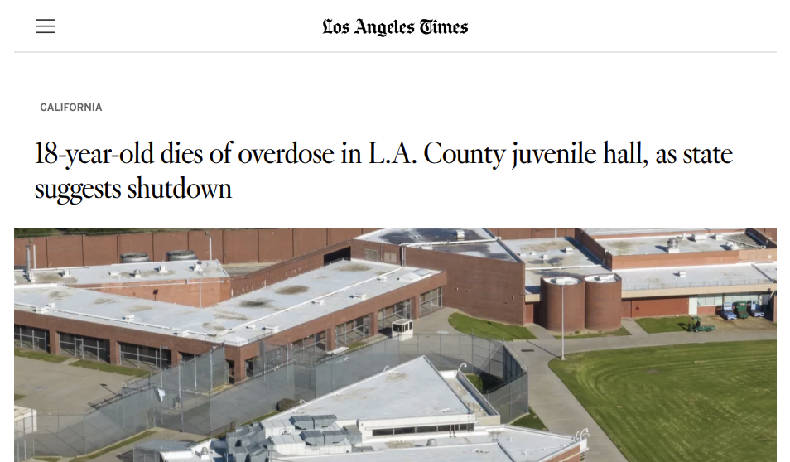


Slide 11
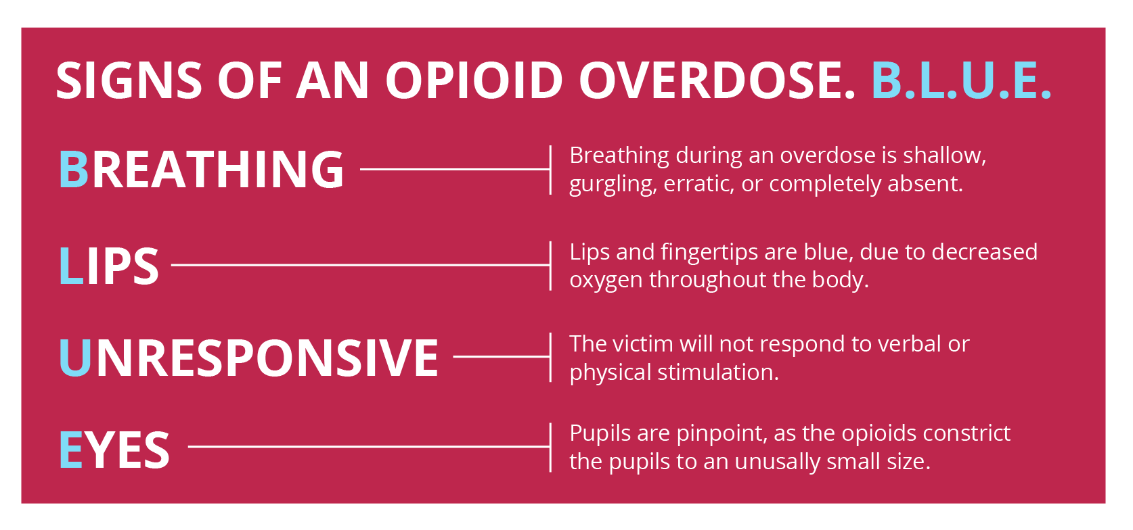
How to save a life
Source: https://www.saveliveskenosha.org/recognize-the-signssave-a-life/

Slide 12
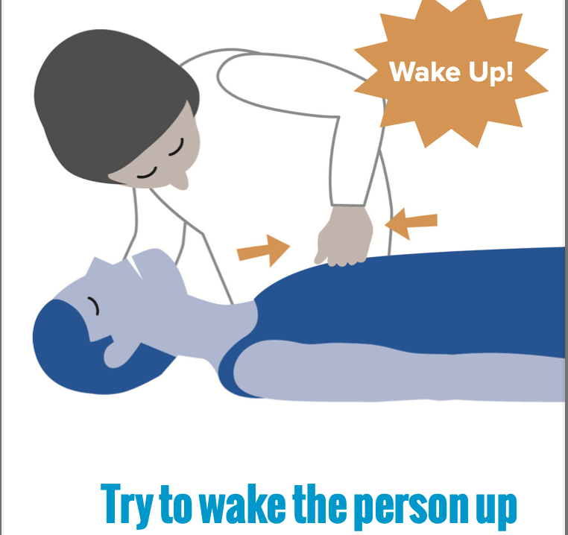
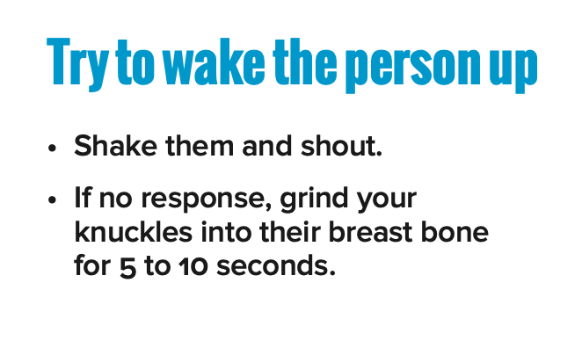
Responding to Suspected Opioid Overdose
Source: National Harm Reduction Coalition

Slide 13
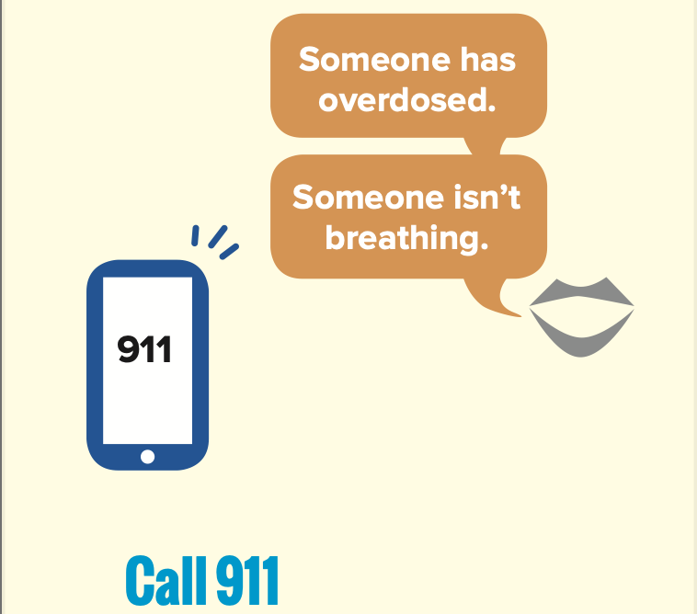
Responding to Suspected Opioid Overdose
Shout out for help! Power in numbers
Activate Medical Code and Call 911
Source: National Harm Reduction Coalition

Slide 14
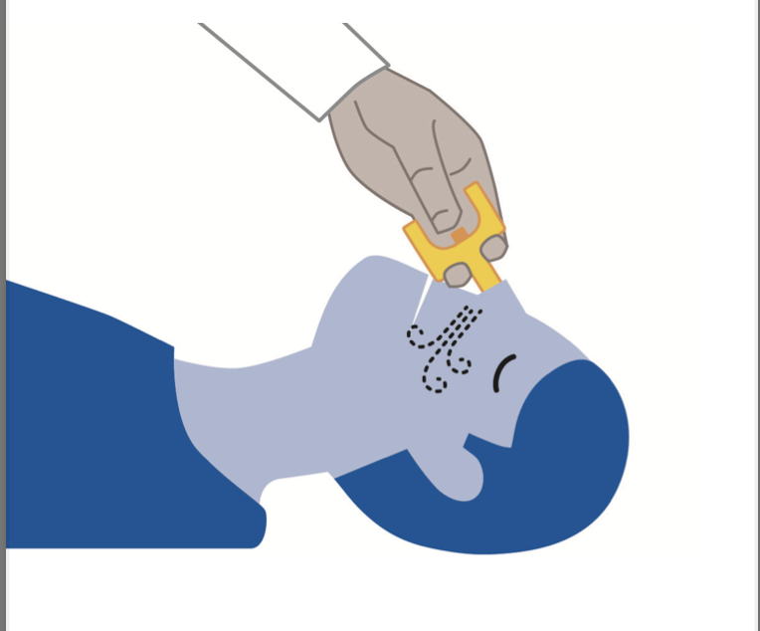
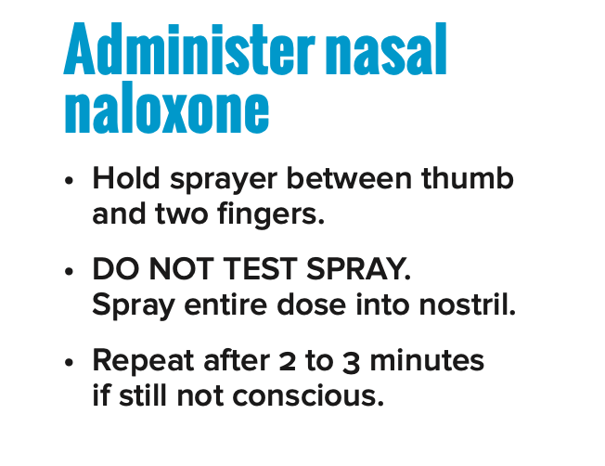
Responding to Suspected Opioid Overdose
Source: National Harm Reduction Coalition

Slide 15
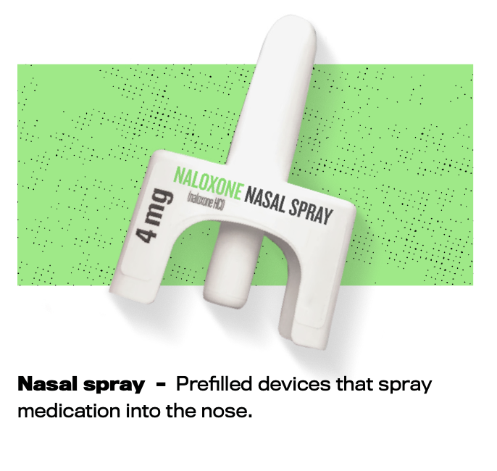
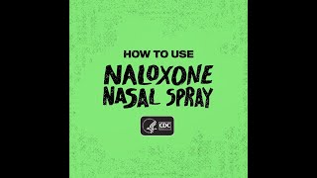
How to use Naloxone Nasal Spray
Source: https://www.cdc.gov/stopoverdose/naloxone/index.html

Slide 16
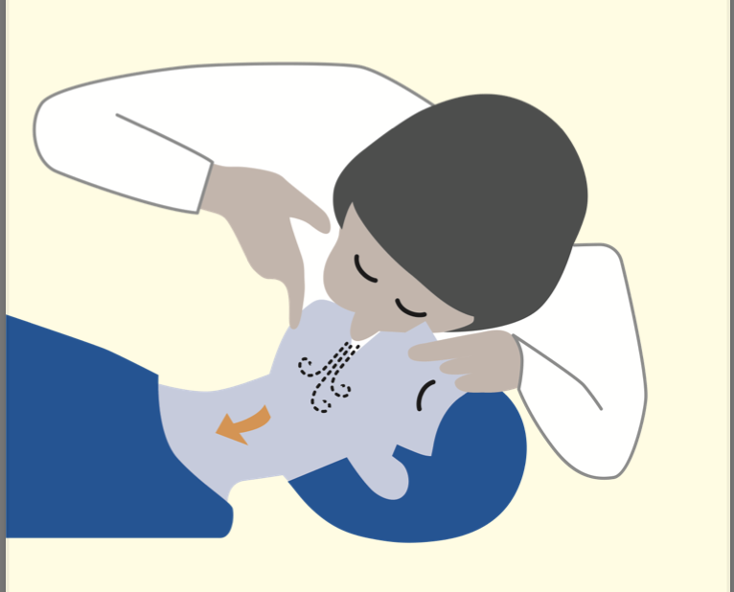
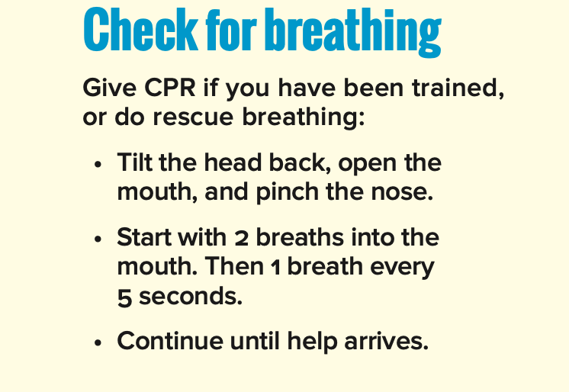
Responding to Suspected Opioid Overdose
Source: National Harm Reduction Coalition

Slide 17
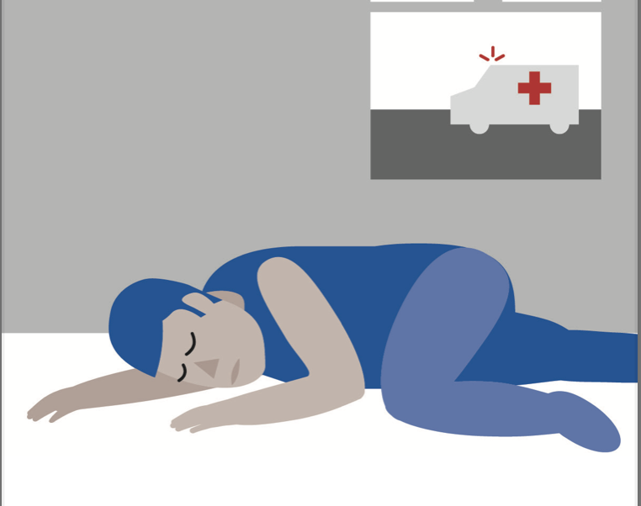
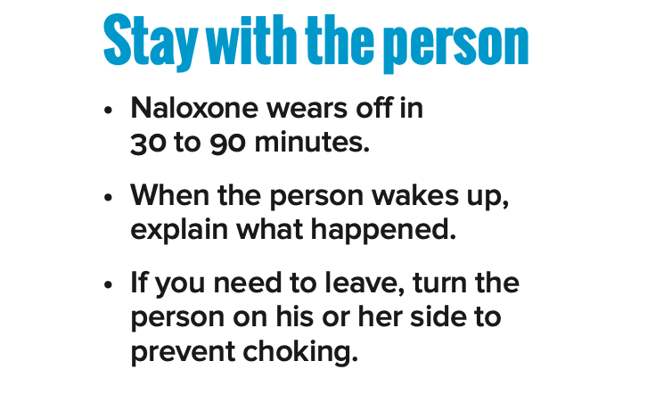
Responding to Suspected Opioid Overdose
Source: National Harm Reduction Coalition

Slide 19
Fight the stigma!
Addiction is a chronic medical disease and return to use (relapse) is a normal part of the course
Addiction is not a moral failing (and neither is return to use)
Society and systems (including healthcare) perpetuate the stigma against people with substance use disorders
We all have an incredible opportunity to be kind to someone who is not expecting it

Slide 20

Quick points on language
The words we use matter!
Person-first language
  “Person with opioid use disorder”
Avoid outdated, stigmatizing, harmful language:
  “substance abuse” or “abuser”
  “drug user”
  “addict”
  “junkie”
  “clean vs. dirty”
NIDA: Words Matter - Terms to Use and Avoid When Talking About Addiction. https://nida.nih.gov/nidamed-medical-health-professionals/health-professions-education/words-matter-terms-to-use-avoid-when-talking-about-addiction. 29 November 2021.

Slide 21
Opioids 101
“Percs”, “Vicodin”, “Norco”, “Oxy”, heroin, fentanyl* (“fent”, “fenny”)
  *Almost all “street” pills now have some fentanyl in them.
Routes of use: oral, intranasal, inhaled, injected
Symptoms or signs of opioid use:
  Pain relief, relaxation, euphoria
  Pupils get small
  Sleepiness, slurred speech, slowness
  Slowed breathing
  Sleepier and sleepier until you can’t be woken up
  Overdose = unresponsive, minimal breathing, skin may turn blue
You cannot overdose from simply touching someone who has used fentanyl
Increasing severity

Slide 22
Opioid Withdrawal
“Acute” withdrawal (starts within first few days after stopping use, usually lasts 4-7 days):
What youth might feel:
Patient reports feeling "bad", like the flu
Anxiety, nausea, poor appetite, cramps, diarrhea, body aches, restlessness, hot and cold, runny/stuffy nose
Cravings to return to use
What you might see:
Irritability, restlessness, sweating, runny/stuffy nose, eye tearing
Dilated pupils, frequent yawning, goosebumps
Nausea/vomiting, diarrhea, shakiness
“Post-acute” withdrawal (can last for weeks to months from last use, without treatment):
Irritability, anxiety or depression, insomnia; cravings may persist for years

Slide 23
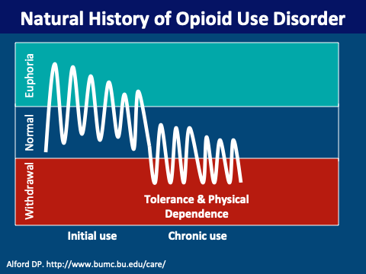

Slide 24
Medications for Opioid Use Disorder
Buprenorphine or Suboxone*
Can stop withdrawal and cravings immediately
Protects against overdose
Life-saving with >50% reduction in all-cause mortality
Chances of relapse to taking opioids ~8 times higher without buprenorphine
Significantly improved retention in treatment, reduced transmission of HIV or Hep C, and improved daily functioning
*Note that Suboxone is a combination of buprenorphine + naloxone; however, the main active ingredient is the buprenorphine
Pearce LA, Min JE, Piske M, Zhou H, Homayra F, Slaunwhite A, Irvine M, McGowan G, Nosyk B. Opioid agonist treatment and risk of mortality during opioid overdose public health emergency: population based retrospective cohort study. BMJ. 2020 Mar 31;368:m772. doi: 10.1136/bmj.m772. PMID: 32234712; PMCID: PMC7190018.
Notes:
Speaker: David

Slide 26
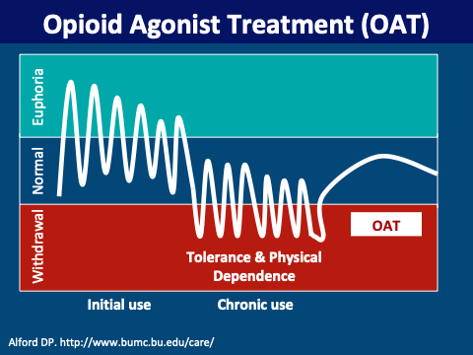

Slide 27
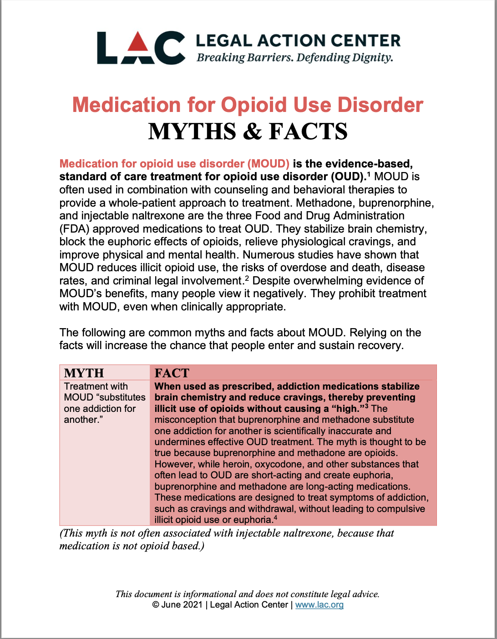
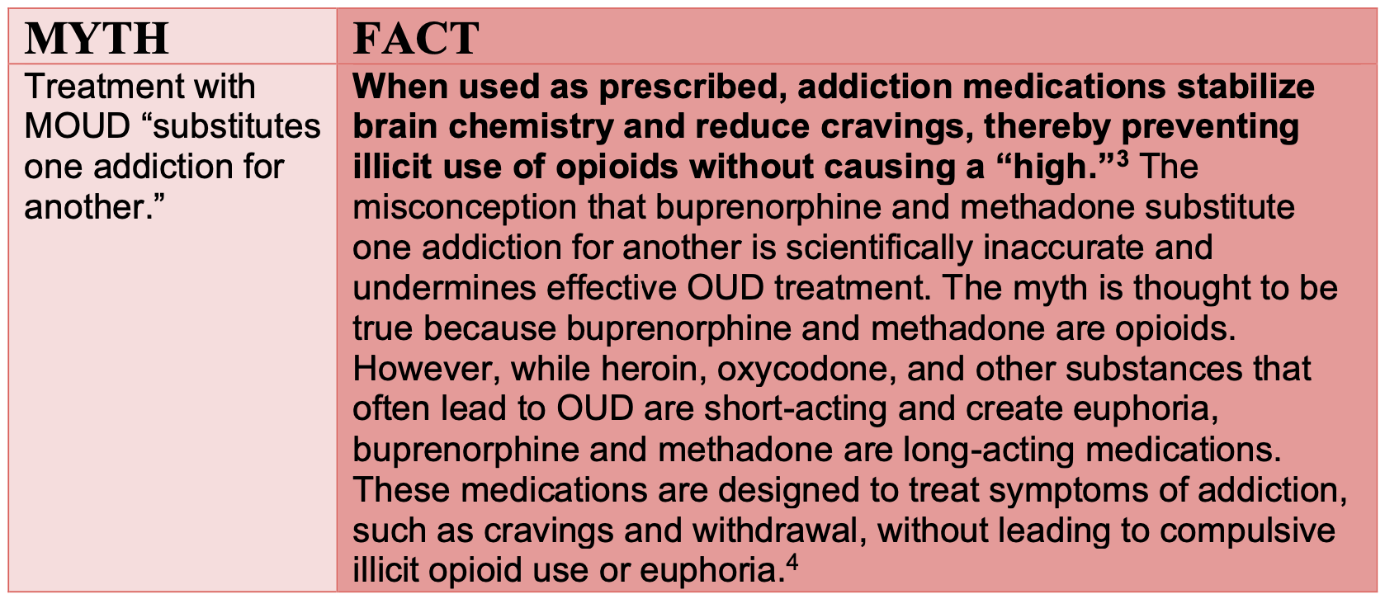
MOUD Misconceptions

Slide 28
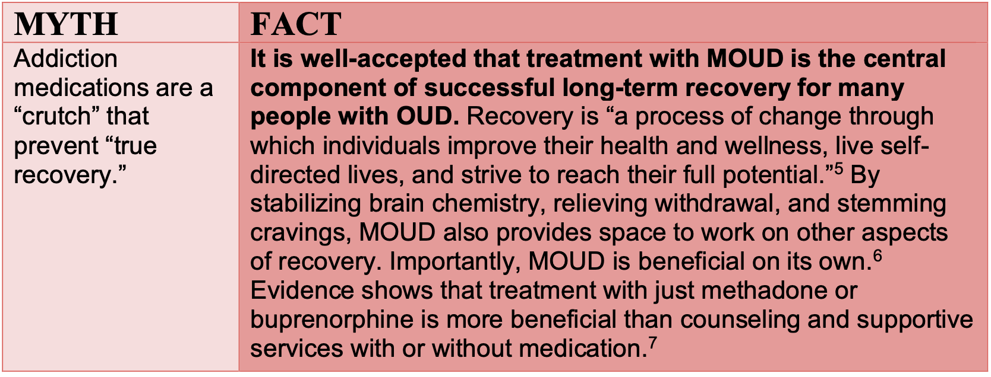
MOUD Misconceptions

Slide 29
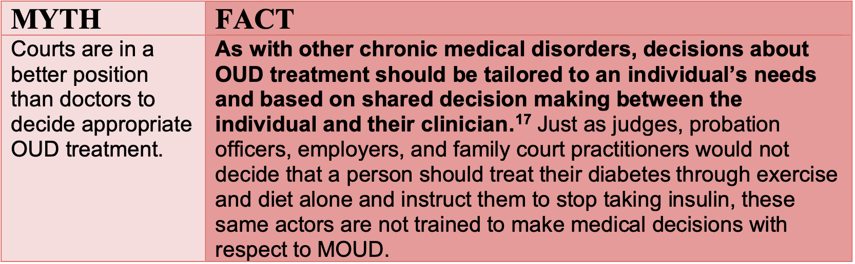
MOUD Misconceptions

Slide 30
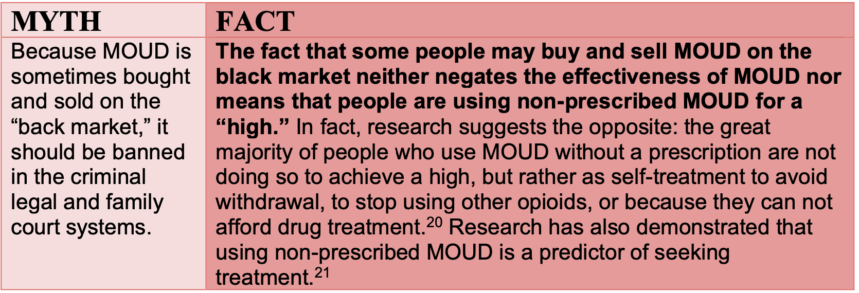
MOUD Misconceptions
For more information and the full document go to https://www.lac.org/assets/files/Myth-Fact-for-MAT.pdf

Slide 31
Who is evaluated by medical
Everyone during their intake examination
Anyone with signs/symptoms of intoxication (slurred speech, confusion, more sleepy, etc.)
Anyone with signs of or a reported withdrawal from a substance (Xanax, Alcohol, Opioids more severe)
  Anyone with any concerns related to their substance use (low threshold policy)
            Openly discussing problems caused by their substance use
Expressed interest in receiving help ”cutting back”
Bringing up their “cravings” or “desires” for a drug
Found to have illicit substances or diverting medications
When in doubt, we encourage staff to call for further eval or have youth write “sick call”
Nursing on-site with Medical Doctor by phone 24/7, Medical Doctor in-house 3-4 times per week

Slide 32
What happens during a visit
Vital Signs and Exam give us data that may help diagnose intoxication/withdrawal and guide treatment
We gather more info such as…
Substances used or are still being used
The amount/types of use (frequency, dose, duration, last use, source, mixtures, etc.)
If they are a minor, asking if parents/guardian aware of their use?
Then we have an open conversation about their substance use and potential next steps:
Motivational interviewing techniques are used to assess current understanding/readiness for change
We assess if they meet criteria for diagnosis of Substance Use Disorder (and if so, the severity)
We discuss treatment options available that may include:
  Substance use counseling (Family Spring, La Familia)
  Guidance referral to address underlying anxiety, depression, ADHD, or PTSD (if present)
  Prescription medications (e.g. buprenorphine)

Slide 33
DSM-V Criteria for Substance Use Disorder
Loss of control
  Substance taken in larger amounts or longer than intended
  Desire or unsuccessful attempt to reduce or control use
  Great deal of time spent obtaining, using, or recovering from use
  Craving
Social problems
  Use causes failure to fulfill obligations at work, school, home
  Continued use despite recurrent social/personal problems
  Important social, occupational, or recreational activities reduced
Risky use
  Use in dangerous situations
  Continued use despite physical/psychological problems
Tolerance
Withdrawal
Mild: 2-3 symptoms
Moderate: 4-5 symptoms
Severe: 6+ symptoms

Slide 34
Work that is ongoing
Updating our intake form with evidence-based substance use screen that can better identify SUD and jumpstart connection to care with physician
Continued collaboration with all of our partners (including those here today)
Education of pediatric residents and addiction medicine fellows to expand upon and improve care in the community
Developing new treatment protocols and guidelines
Improving the connection to care and substance use treatment upon release

Slide 35

Are you struggling with fentanyl, heroin, or pain pills? Alcohol? Meth or cocaine?
We can help today.
Ask your doctor about Bridge and call/text (510) 545-2765
Talk to a Substance Use Navigator about:
Starting buprenorphine (Suboxone)
Medications to help with meth or alcohol use
Monday-Friday 9am-5pm

Slide 36
Take-Home Points
Substance use disorders and drug overdoses are extremely prevalent and undertreated in our youth (and significant racial disparities exist)
Buprenorphine is one medication that can reduce the risk of death dramatically in people with Opioid Use Disorder and is the standard of care
Addiction is a chronic medical disease and language/actions are important in fighting the associated stigma
Through our collaboration and partnership we have the power to provide life saving care for our youth!

Slide 37




Questions?
You can find more info at:
https://www.samhsa.gov/find-help/overdose
https://harmreduction.org
https://bridgetotreatment.org/
https://www.cdph.ca.gov/Programs/CCDPHP/SAPB/

