Slide 1

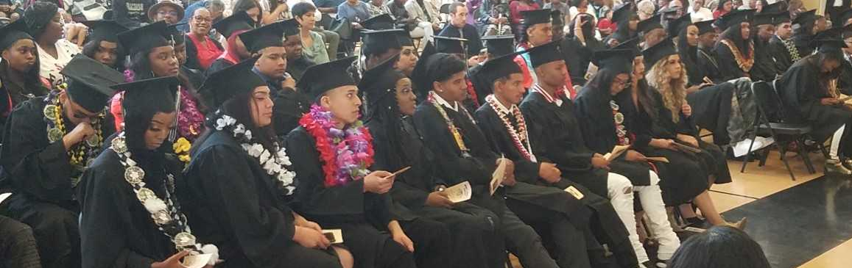

Safe Passages 501(c)(3) Alameda County Probation Department Post Release Reentry Services rogramming
BUILDING PATHWAYS TO COMMUNITY SUCCESS FOR OUR KIDS

Slide 2
Organizational Capacity – History and Experience
Over 28 years of experience providing holistic and culturally responsive programs and activities in Alameda County.
Has held several contracts with public systems for prevention and intervention services for opportunity youth: US DOL, CDPH, AC SSA, ACPD, City of Oakland, OUSD, and ACOE.
Lead entity for the sustainability of the California Reducing Disparities Program (CRDP) Behavioral Health Initiative funded by the CDPH.
Currently working in 20 school communities across three school districts in Alameda County: OUSD, Emeryville Unified, Alameda County Office of Education.
Currently provided concurrent enrollment courses in partnership with Peralta Community College District.
Notes:
Safe Passages has a distinguished track record of providing comprehensive violence prevention and intervention services to priority populations in Alameda County, particularly adjudicated and systems- involved youth residing in crime-impacted and economically disenfranchised areas of Alameda County. Our commitment to community-defined evidence practices, community engagement, and collaborative partnerships has significantly improved outcomes for the priority populations we serve.

Slide 3
Types of Services Provided
Assessment & Planning (Validated Psycho-Social Assessment, Life & Career Roadmap Development, Life Map Creation)
Life Coaching & Support (1:1 Life Coaching Sessions, Family Engagement Activities, Incentive Payments to Support Engagement)
Education Support (Re-enrollment in School/Educational Programs, School System Navigation, Summer Institute Participation, Learning Trips & Experiential Activities_
Employment & Career Readiness (1:1 Job Readiness Coaching, Job Readiness Training Sessions, Paid Internships & Employment Opportunities (including Safe Passages)
Systems Navigation & Advocacy (Public Systems Navigation (education, justice, healthcare, social services), Court Advocacy, Referrals to Additional Support Service
Notes:
The Safe Passages Law and Social Justice Life Coaching Program (LSJ Life Coaching Program) is a prime example of our commitment to supporting adjudicated youth ages 14 to 21. This Community Defined Evidence Practice (CDEP) addresses the mental and behavioral health needs of youth and young adults exposed to trauma, poverty, racism, and the juvenile justice system. Through the LSJ Life Coaching Program, we provide comprehensive support services, including mentorship, workforce development, and trauma-informed care, to empower youth and break the cycle of violence and incarceration.
SP has served 98 African American and Afro-Latino youth through the SP California Reducing Disparities Project/CRDP. The project serves youth at risk of systems involvement, ages 16-21, who live in Oakland’s most crime and poverty-impacted neighborhoods; it aims to prevent and/or reduce the effects of exposure to chronic stress, exposure to racism, disenfranchisement from the education system, and juvenile justice system involvement. Its components aim to decrease mental illness, school failure/dropout, and incarceration/recidivism; program components further aim to improve or increase coping skills, self-regulation, relationships with caring adults, access to services, employment, and family engagement. CRDP participant outcomes include:

Slide 4
Referral Process & Initiation
Where Referrals Come From
Formal: OUSD administrators/staff, COST meetings, partner agencies.
Informal: Life Coaches identifying youth in the community or on school sites.
Self-Referrals: Youth and families reaching out directly.
Post Release referrals come directly from DPO
After a Referral
Life Coach connects with youth/family.
Intake process begins (forms, needs assessment, goal setting).
Immediate needs identified and initial supports provided.
Why Presence Matters
Being regularly on OUSD sites makes us visible, builds trust, and ensures students and staff know we are accessible.

Slide 5
Data on Youth Serviced
July 01, 2024 – June 30, 2025
46 Justice Impacted Youth, 1072 hours of service
79 Life and Career Road Maps completed
46 Internships and Employment placement
Communities served: 94601, 94603, 94605, 94607, 94621
Notes:
The Safe Passages Law and Social Justice Life Coaching Program (LSJ Life Coaching Program) is a prime example of our commitment to supporting adjudicated youth ages 14 to 21. This Community Defined Evidence Practice (CDEP) addresses the mental and behavioral health needs of youth and young adults exposed to trauma, poverty, racism, and the juvenile justice system. Through the LSJ Life Coaching Program, we provide comprehensive support services, including mentorship, workforce development, and trauma-informed care, to empower youth and break the cycle of violence and incarceration.
SP has served 98 African American and Afro-Latino youth through the SP California Reducing Disparities Project/CRDP. The project serves youth at risk of systems involvement, ages 16-21, who live in Oakland’s most crime and poverty-impacted neighborhoods; it aims to prevent and/or reduce the effects of exposure to chronic stress, exposure to racism, disenfranchisement from the education system, and juvenile justice system involvement. Its components aim to decrease mental illness, school failure/dropout, and incarceration/recidivism; program components further aim to improve or increase coping skills, self-regulation, relationships with caring adults, access to services, employment, and family engagement. CRDP participant outcomes include:

Slide 6
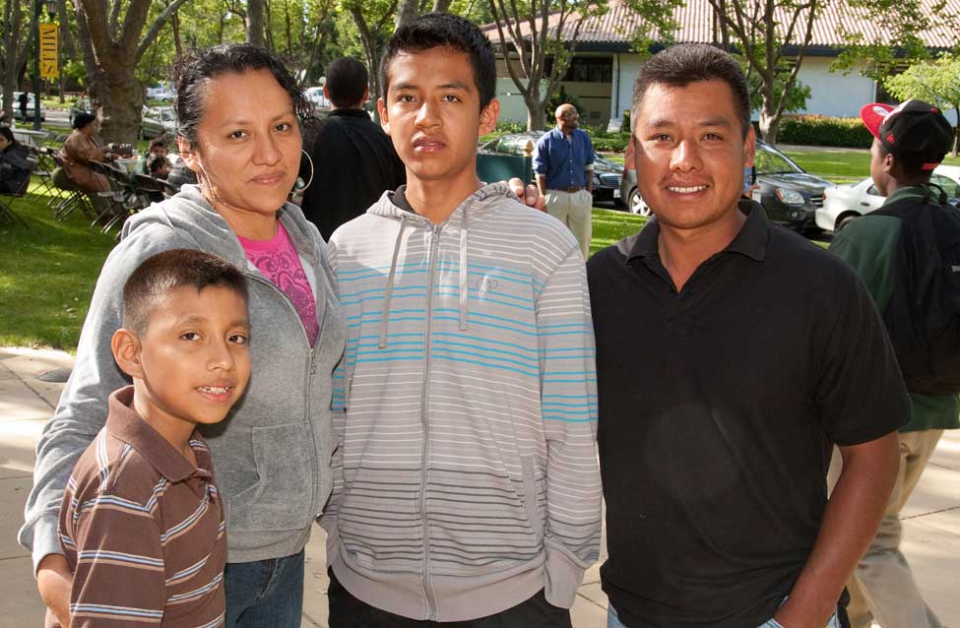
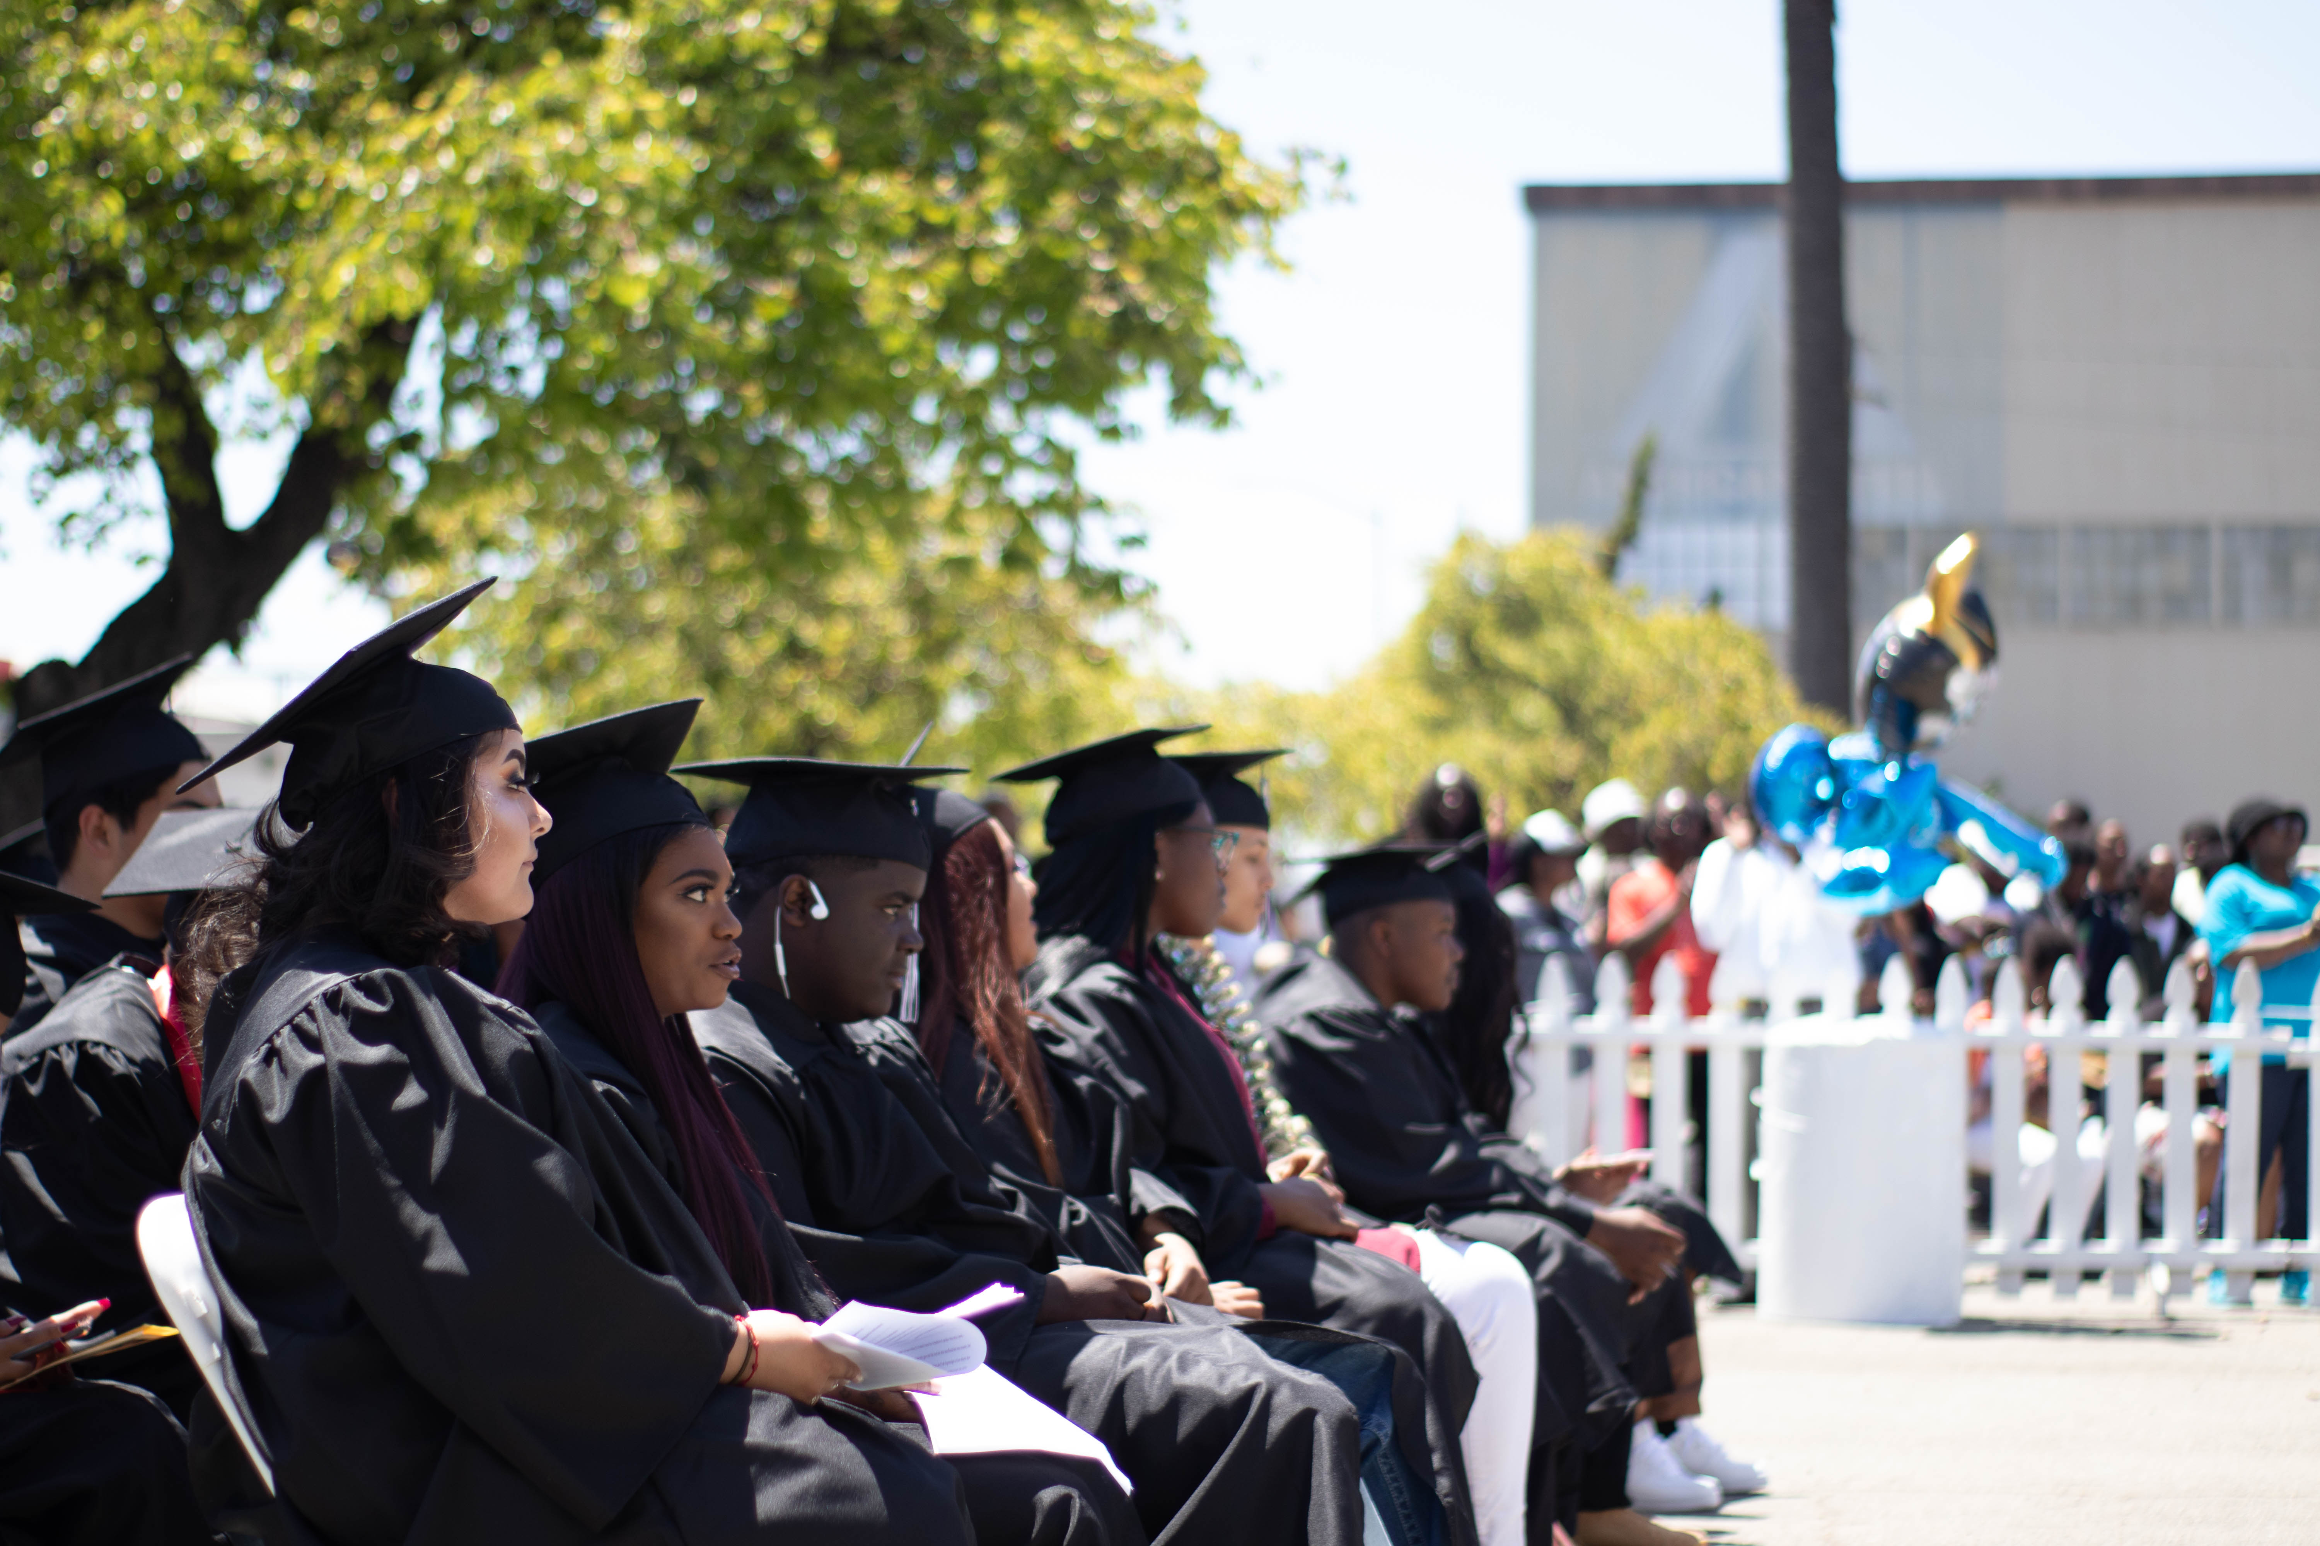
Mission
Safe Passages disrupts the cycle of poverty by engaging youth and families to build and drive a continuum of services that supports student success and community development.

Slide 7
SP Post Release Team
Josefina Alvarado Mena. Esq., Chief Executive Officer
Jonathan Brumfield, M.A., Executive Director, Youth Development
Gary B. Mallare, Ph.D., Life Coaching Program Manager
Alfonso Silva, MSW, Reentry Life and Career Roadmap Coach
Jasmin Medina, Reentry Life and Career Roadmap Coach
Martin Hurtado, Reentry Life and Career Roadmap Coach
Kimiko Tahara, Evaluation and Data Manager
Notes:
The Safe Passages Law and Social Justice Life Coaching Program (LSJ Life Coaching Program) is a prime example of our commitment to supporting adjudicated youth ages 14 to 21. This Community Defined Evidence Practice (CDEP) addresses the mental and behavioral health needs of youth and young adults exposed to trauma, poverty, racism, and the juvenile justice system. Through the LSJ Life Coaching Program, we provide comprehensive support services, including mentorship, workforce development, and trauma-informed care, to empower youth and break the cycle of violence and incarceration.
SP has served 98 African American and Afro-Latino youth through the SP California Reducing Disparities Project/CRDP. The project serves youth at risk of systems involvement, ages 16-21, who live in Oakland’s most crime and poverty-impacted neighborhoods; it aims to prevent and/or reduce the effects of exposure to chronic stress, exposure to racism, disenfranchisement from the education system, and juvenile justice system involvement. Its components aim to decrease mental illness, school failure/dropout, and incarceration/recidivism; program components further aim to improve or increase coping skills, self-regulation, relationships with caring adults, access to services, employment, and family engagement. CRDP participant outcomes include:

Slide 8
Life Coaching Model
The Safe Passages Law and Social Justice Life Coaching Program (LSJ Life Coaching Program) is a Community Defined Evidence Practice (CDEP) rooted in African American and Latinx cultural values and trauma-informed care.
Addresses the behavioral and mental health needs of adjudicated and at-risk youth of color, ages 14–25, residing in underserved neighborhoods, communities impacted by chronic poverty, racism, educational disenfranchisement, and juvenile justice system involvement.
A comprehensive, intensive, trauma-informed, culturally grounded services, including individualized life coaching, clinical case management, mentorship, family engagement, life skills education, navigate public systems (education, justice, healthcare, social services), offer court accompaniment, support with obtaining legal documents, and co-develop Life and Career Roadmaps with youth and families.
At its core, the Life Coaching Program aims to empower youth and break the cycle of violence and incarceration for youth of color by building resilience, fostering culturally rooted healing, and promoting long-term mental wellness and stability.
Notes:
The Safe Passages Law and Social Justice Life Coaching Program (LSJ Life Coaching Program) is a prime example of our commitment to supporting adjudicated youth ages 14 to 21. This Community Defined Evidence Practice (CDEP) addresses the mental and behavioral health needs of youth and young adults exposed to trauma, poverty, racism, and the juvenile justice system. Through the LSJ Life Coaching Program, we provide comprehensive support services, including mentorship, workforce development, and trauma-informed care, to empower youth and break the cycle of violence and incarceration.

Slide 9
Post Release Reentry Program
Phase 1: Stabilize & Reconnect (Months 1–2)
Welcome youth home, address immediate needs.
Intensive contact, daily check-ins, resource coordination.
Engage family, host “Welcome Home” celebration.
Phase 3: Strengthen Wellness & Skills (Months 5–8)
Focus on emotional, mental, and social growth.
Build problem-solving and communication skills.
Expand support network, celebrate 6-month milestone.
Phase 2: Build Trust & Structure (Months 3–4)
Strengthen relationships and routines.
Frequent meetings, flexible incentives.
Refine reentry plan, maintain consistent support.
Phase 4: Sustain Progress & Transition (Months 9–12)
Link to mentors, programs, and long-term supports.
Prepare for transition with warm hand-off plan.
Celebrate 1-year milestone and accomplishments.
In & Out-of-State Support: Support is provided for youth whether they are in or out-of-state.

Slide 10
Barrier Removal and Support Activities
Housing & Stability
Secured stable housing with rental assistance.
Coordinated with probation/court teams.
Education & Career Readiness
Paid school fees and provided materials.
Started career exploration and shared job leads.
Travel & Transition Support
Arranged travel and accompanied youth.
Provided clothing and personal care items.
Documentation & Financial Literacy
Assisted with ID and required documents.
Linked to financial literacy courses.
Health & Wellness
Referred to local clinics and therapist for follow-up care.
Financial Incentives & Support
Provided gift card incentives and stipends
Offered transportation assistance.
Engagement & Case Management
Maintained daily contact and weekly meetings.
Coordinated services with probation.

Slide 11
Phase 1 Case Success Story
A recently released youth began the program with urgent needs in housing, education, and stability. Within weeks, the Life Coach secured safe housing with rental assistance, supported school re-enrollment by covering fees and materials, and introduced career exploration tools with job leads.
To ensure a smooth transition, the Life Coach arranged travel back to the community, provided clothing and personal care items, and assisted with obtaining identification documents. The youth was also connected to free financial literacy courses and local clinics for ongoing health and wellness support.
Daily check-ins, multiple weekly meetings, and close coordination with probation maintained strong engagement. Gift card incentives, stipends, and transportation assistance encouraged participation, removed barriers, and reinforced steady progress toward long-term stability.

Slide 12
CONTACT US
www.safepassages.org
Stay Connected With Us
Josefina Alvarado Mena, CEO
jalvarado@safepassages.org
Jonathan Brumfield, ED Youth and Workforce Development Director
jbrumfield@safepassages.org
Lara Sichi, Development Associate Director
lsichi@safepassages.org
@SafePassages
@SafePassages
https://www.facebook.com/SafePassages

